Slide 1
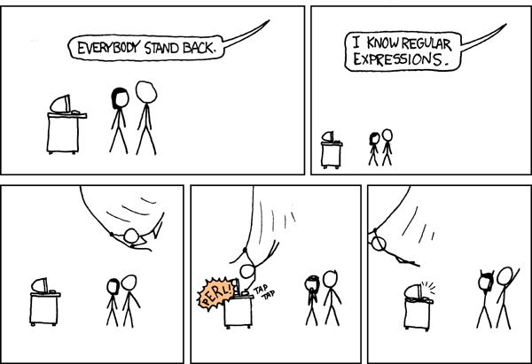
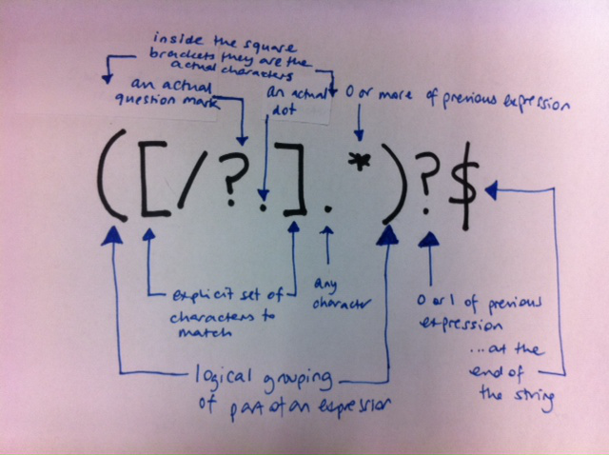
Intro & Regular Expressions
Spring 2024, Week 1
January 19, 2024

Slide 2
Check-in, intros

Slide 3

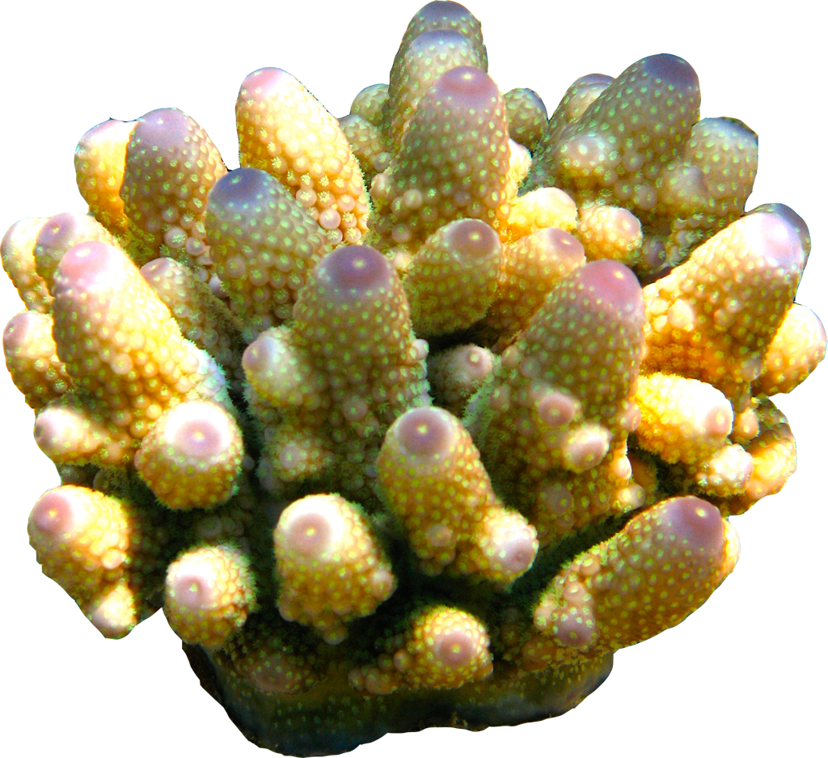


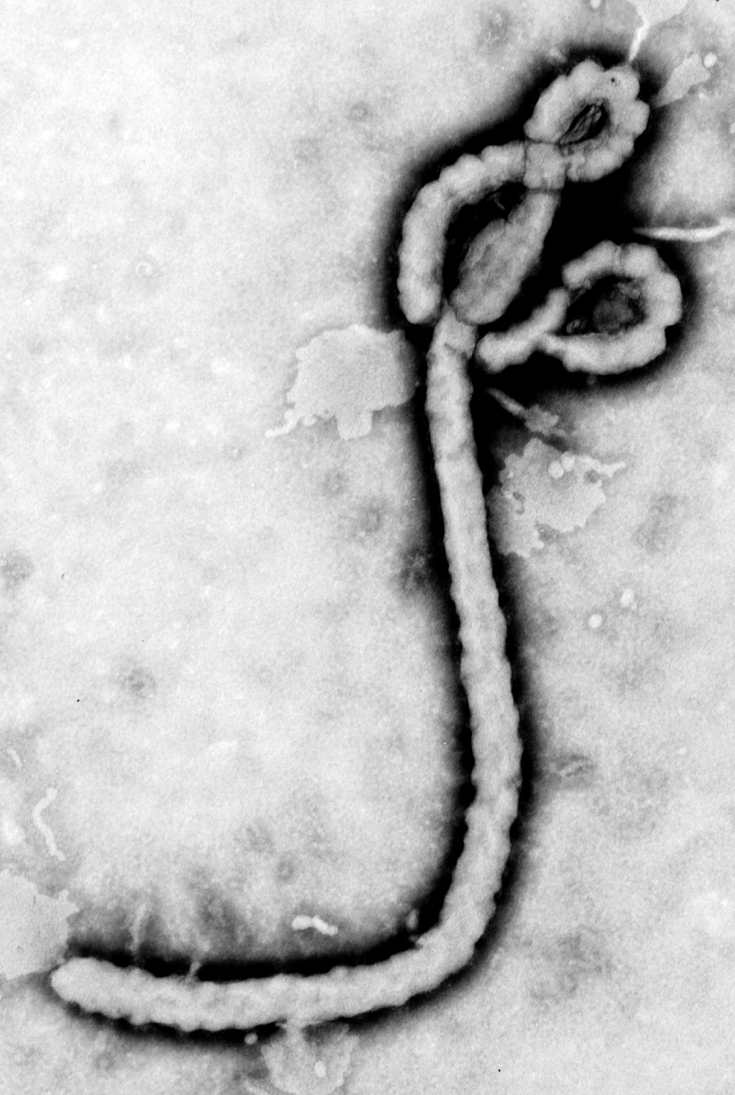
PhD - Evolutionary genetics
PostDoc - Pathogen genomics
Associate Professor
Dept of Biological Sciences
Pathogen and Microbiome Institute

Slide 4
Intros
Your name (Optional: pronouns)
Check-in
Your research focus
A data processing/analysis challenge

Slide 5
Outline
Course organization
Plain text files
Regular expressions

Slide 6
Course organization

Slide 7
What this course is:
What it isn’t:
Intro to general computing techniques broadly applicable to many research-related tasks
A bioinformatics class

Slide 8
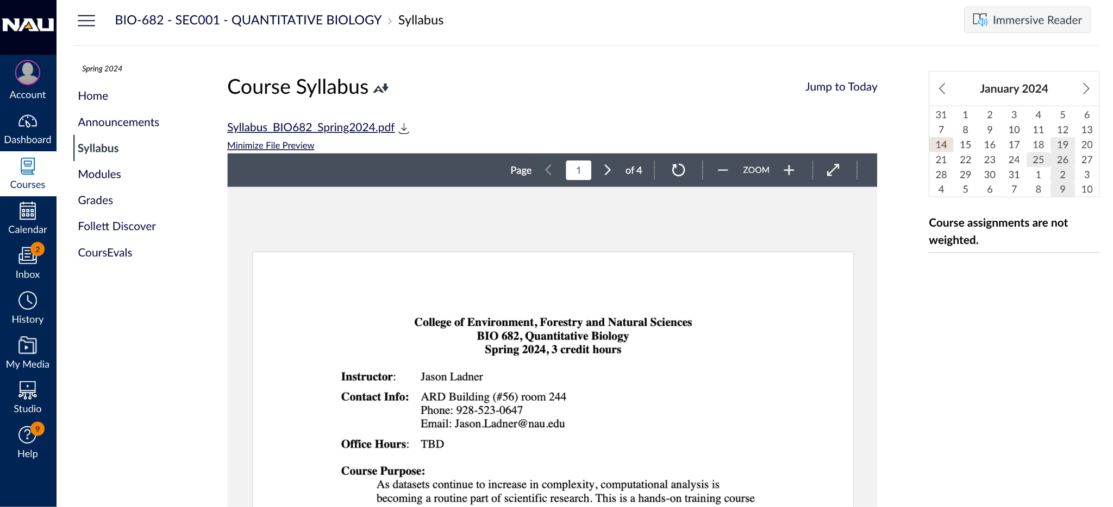
Syllabus on Canvas

Slide 9

Required text
Haddock, S. H. D. and Dunn, C. W. (2010). Practical Computing for Biologists. Sinauer Associates
http://practicalcomputing.org/
Reading must be complete PRIOR to class

Slide 10
Class organization
New Content
(First 11 weeks)
Individual projects
(Last 4 weeks)
Individual coding projects
Topic of your choice
2 work weeks
2 weeks for presentations
Lectures
Demos
In class work time (homework assignments)

Slide 11
Assignments
One assignment per week (weeks 1-11)
Focus on hands-on time in class (may need to complete outside of class)
Always due by 11:59 pm on Thursday
Can submit 1 revision per assignment

Slide 12
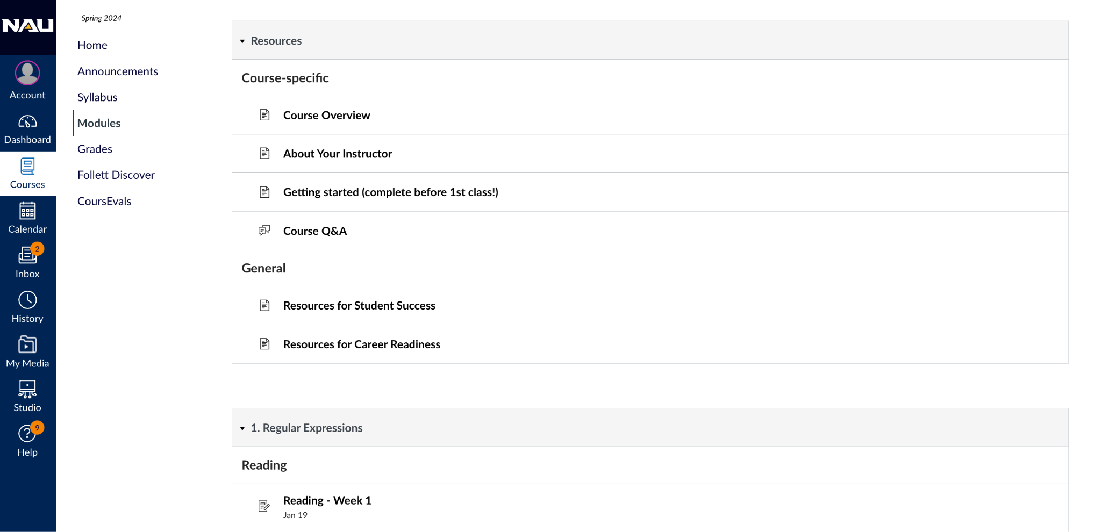
Modules page in Canvas

Slide 13
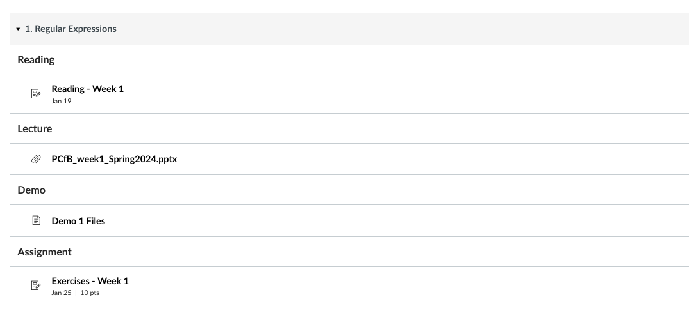
Access assignments via Modules

Slide 14
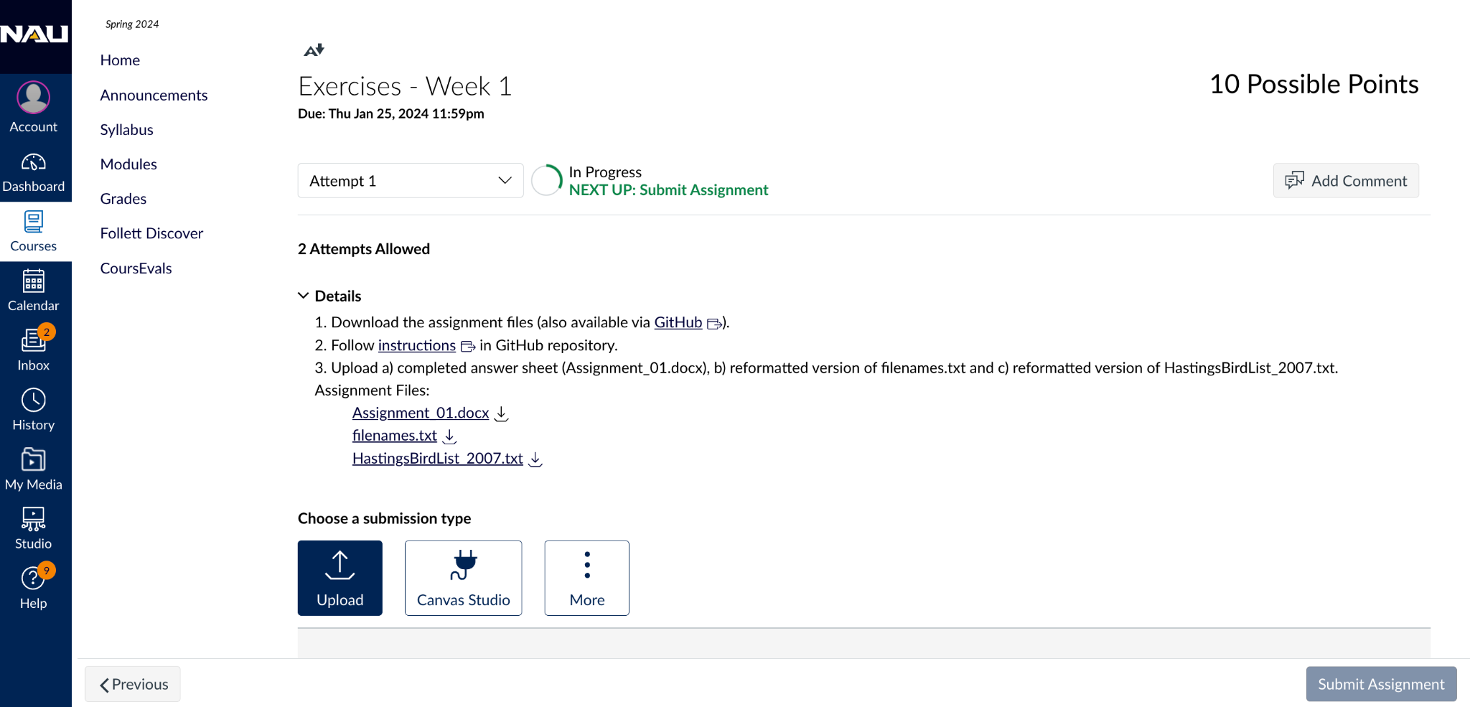
Assignments submitted via Canvas

Slide 15
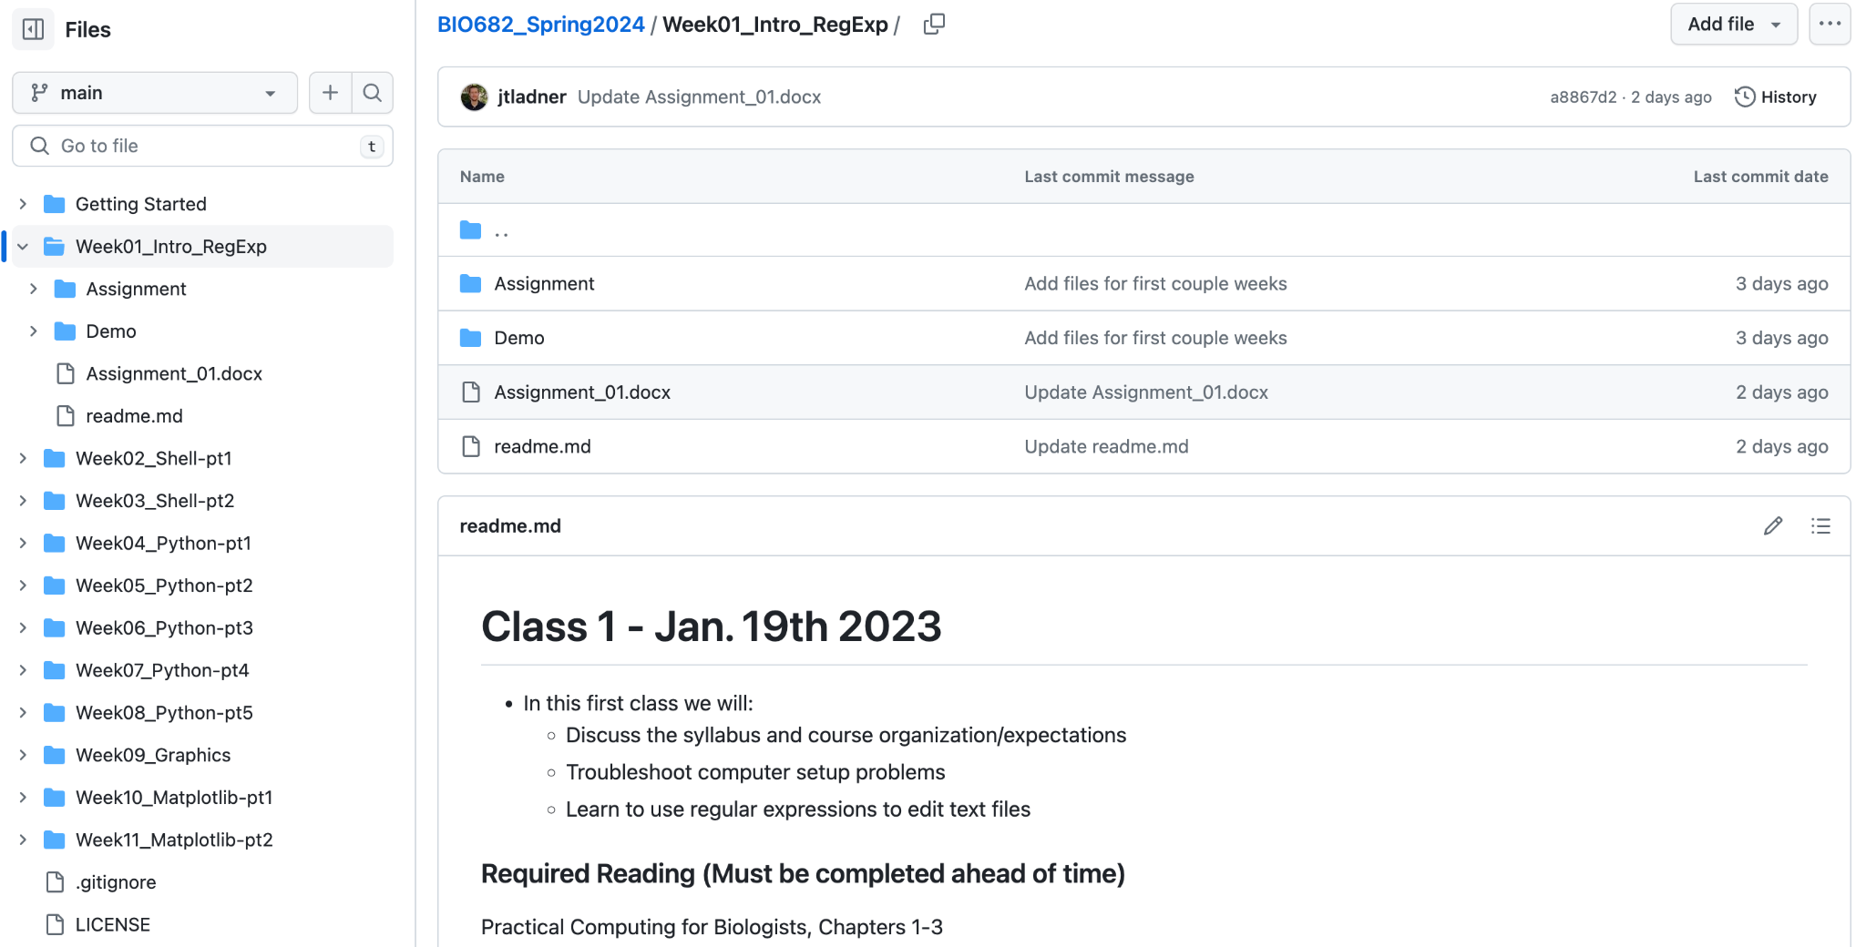



Slide 16
“Pulling” GitHub updates

Slide 17
Grading
Assignments (30%)
Attendance/Participation (30%)
Final Project/Presentation (40%)

Slide 18
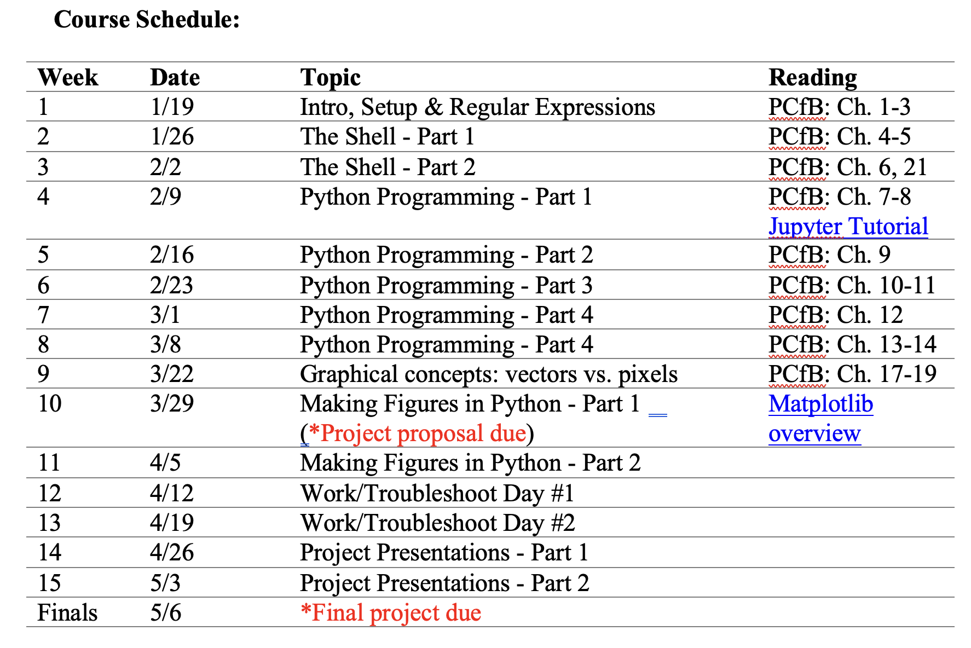
Final project - deadlines

Slide 19
Computer setup
Text Editor
Command line terminal
GitHub Repository
https://github.com/jtladner/BIO682_Spring2024/tree/main/Getting%20Started

Slide 20
Plain text files

Slide 21
Plain text file
Pure sequence of character codes
No formatting (e.g., text size, color, font, spacing)
Human and machine readable
Standardized

Slide 22
Which of these formats are NOT plain text?
Excel (.xlsx)
html
OpenOffice (.odf)
Google Sheet
text (.txt)
fasta
markdown
xml
Google Doc
nexus
json
Word (.doc)
rich text (.rtf)
python script (.py)
tab-separated (.tsv)

Slide 23
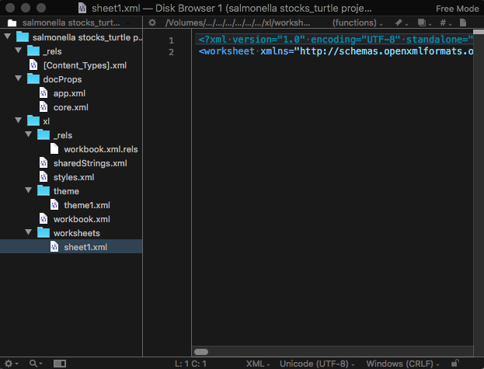
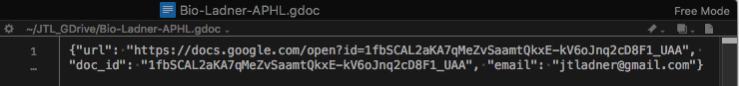
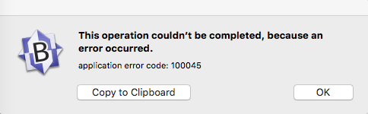
Viewing non-plain text in text editor
.xlsx/.docx
Google Doc
Google Sheet

Slide 24
Whitespace
Space
Tab
End of line

Slide 25
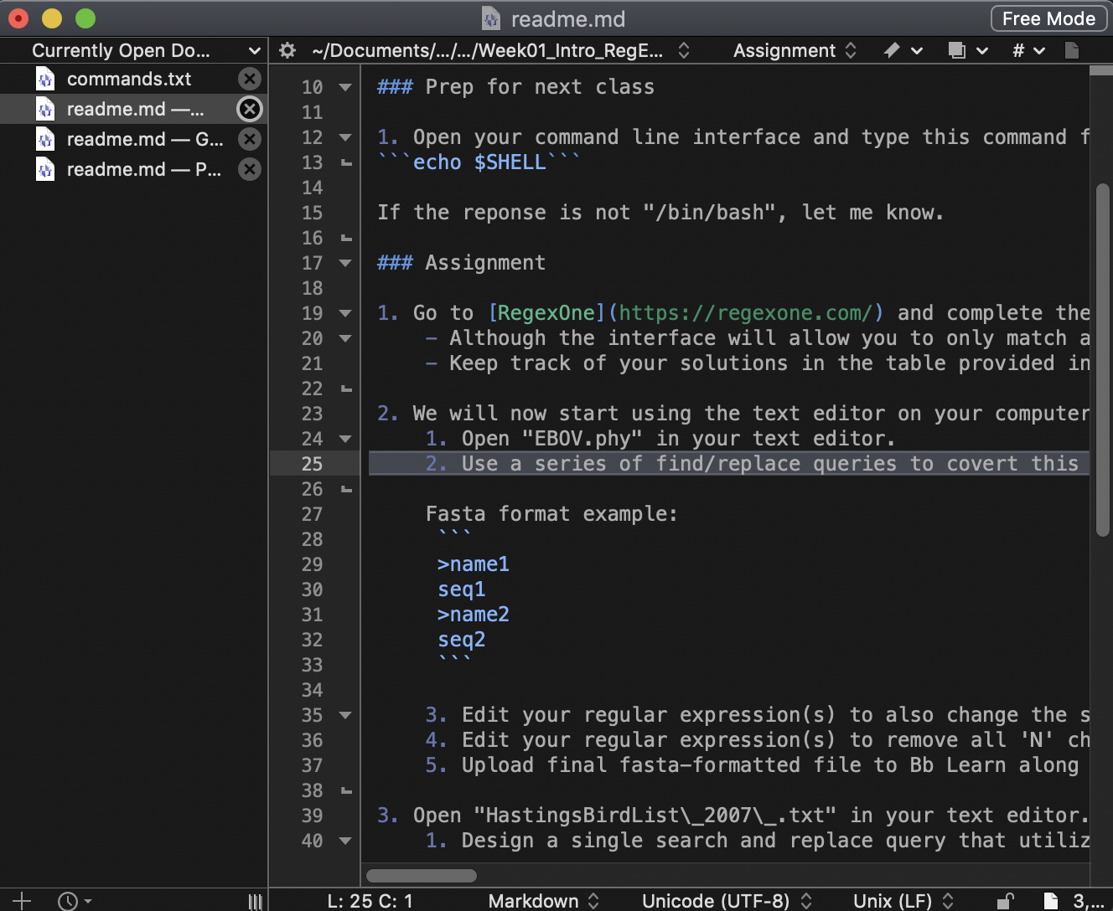
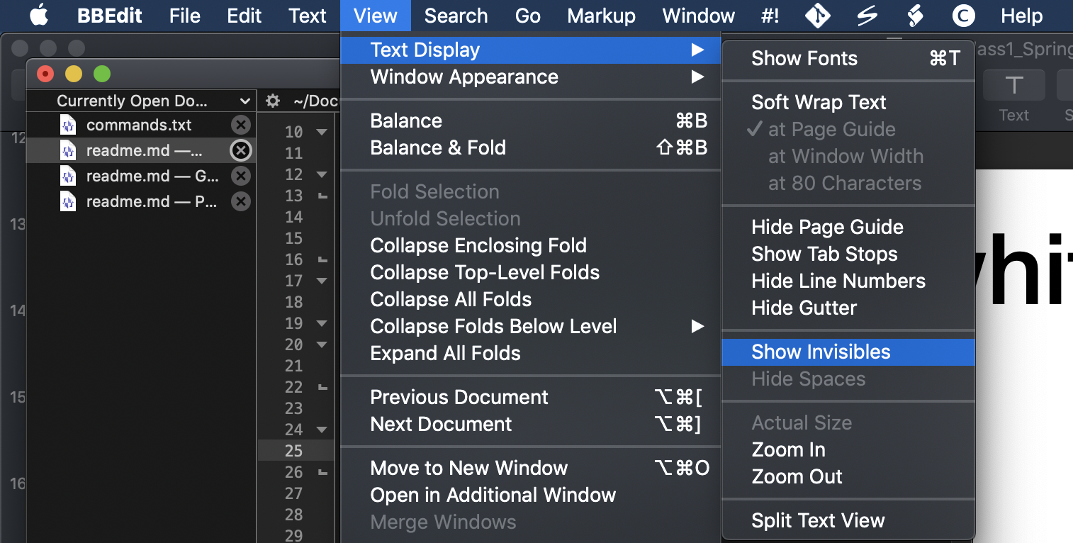
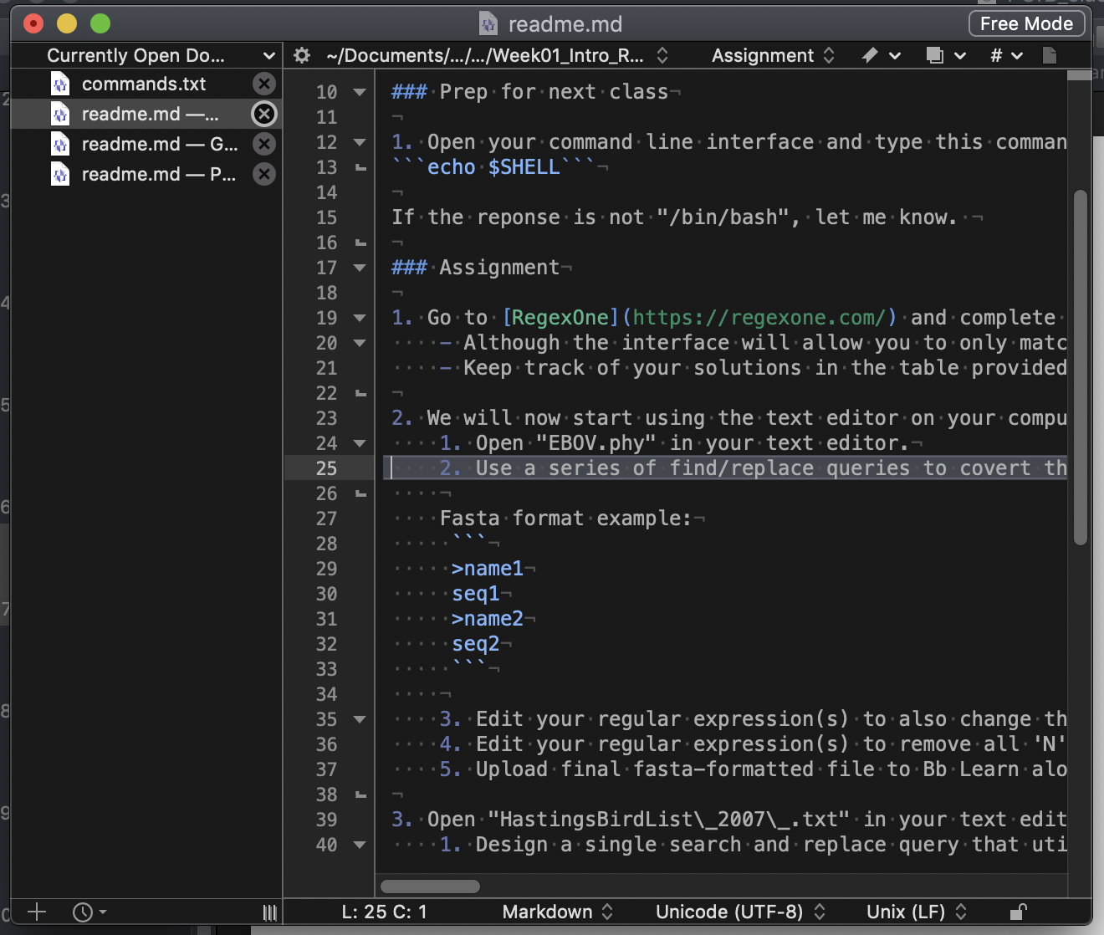
Visualizing white space (BBEdit)

Slide 26
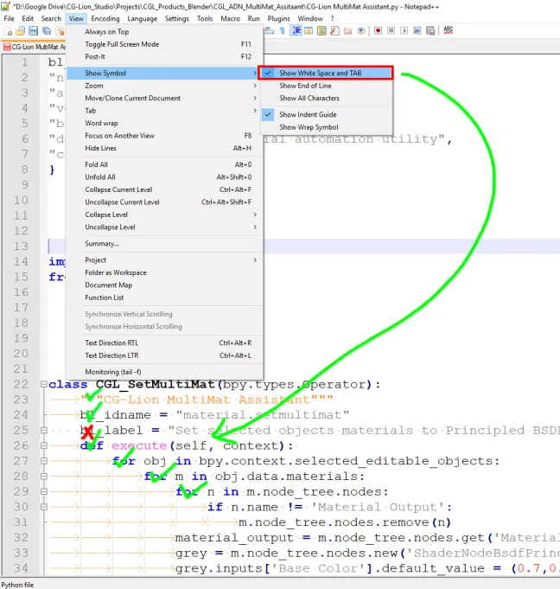
Visualizing white space (Notepad++)

Slide 27
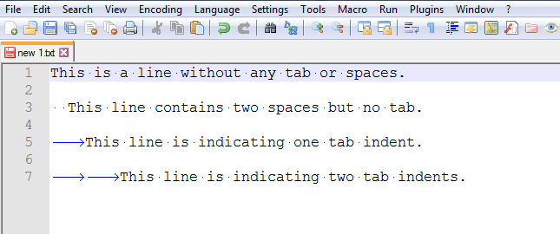
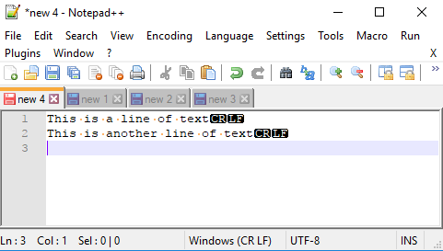
BBEdit
Notepad++

Slide 28
End of line characters
differ by OS
Line feed (LF) - Mac OSX, Linux
Carriage return (CR) - Mac OS9 and earlier
Carriage return + line feed (CRLF) - Windows

Slide 29
Regular expressions

Slide 30
Regular expressions
(a.k.a. regex, regexp)
Powerful find and replace toolkit
Understood by many text editors, programming languages and even search engines
Power comes from wildcard operators

Slide 31
\d
\w
\s
.

Slide 32
\w+
\w*
\w?

Slide 33
[ABC]
[^ABC]
[A-C]

Slide 34
(ABC)
(AB)C
((AB)C)

Slide 35
Anchors
^
$

Slide 36
Tips
Try PCfB methodology
copy (1 version of) target text into search dialog
replace text with wildcards, piece by piece
Be as specific as possible
Build in redundancies

Slide 37
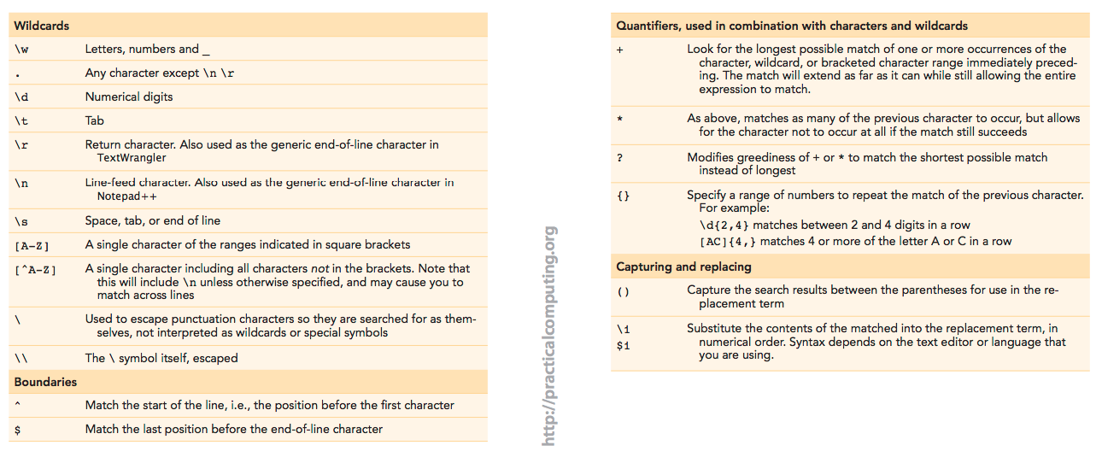
Regexp reference tables
http://practicalcomputing.org/files/PCfB_Appendices.pdf

Slide 38
Questions about the reading?

Slide 39
Demos

